Slide 1
IoT based Monitoring with Alert and Automation
Name : Trezen Parmar
Enrollment no. : 180140111059
Subject : Mini-project
Branch & Semester : Electronics & Communication Engineering / 7th Semester
Government Engineering College, Bharuch
June, 2021

Slide 2
Presentation Outline
Introduction.
Working and Model.
Details of Components and Services.
Advantages.
Conclusion.

Slide 3
Introduction
Have you ever wished to have a fully automatic monitoring system to monitor specific changes in the environment at home or at work ?
Have you imagined controlling your house remotely whenever you like, even to avoid hazardous situations ?
Yes, This is what my mini project is all about.
“IoT based Monitoring with Alert and Automation”

Slide 4
What does my project really do ?
Multiple sensors interfaced to collect real time data.
Connects to the local network via Wi-Fi.
Sends data to Thingspeak to store, process and visualize.
Alerts the user when data exceeds a predefined value.
Immediate action to control data exceeding with the help of automation of various appliances which you can control on your smartphone immediately.

Slide 5
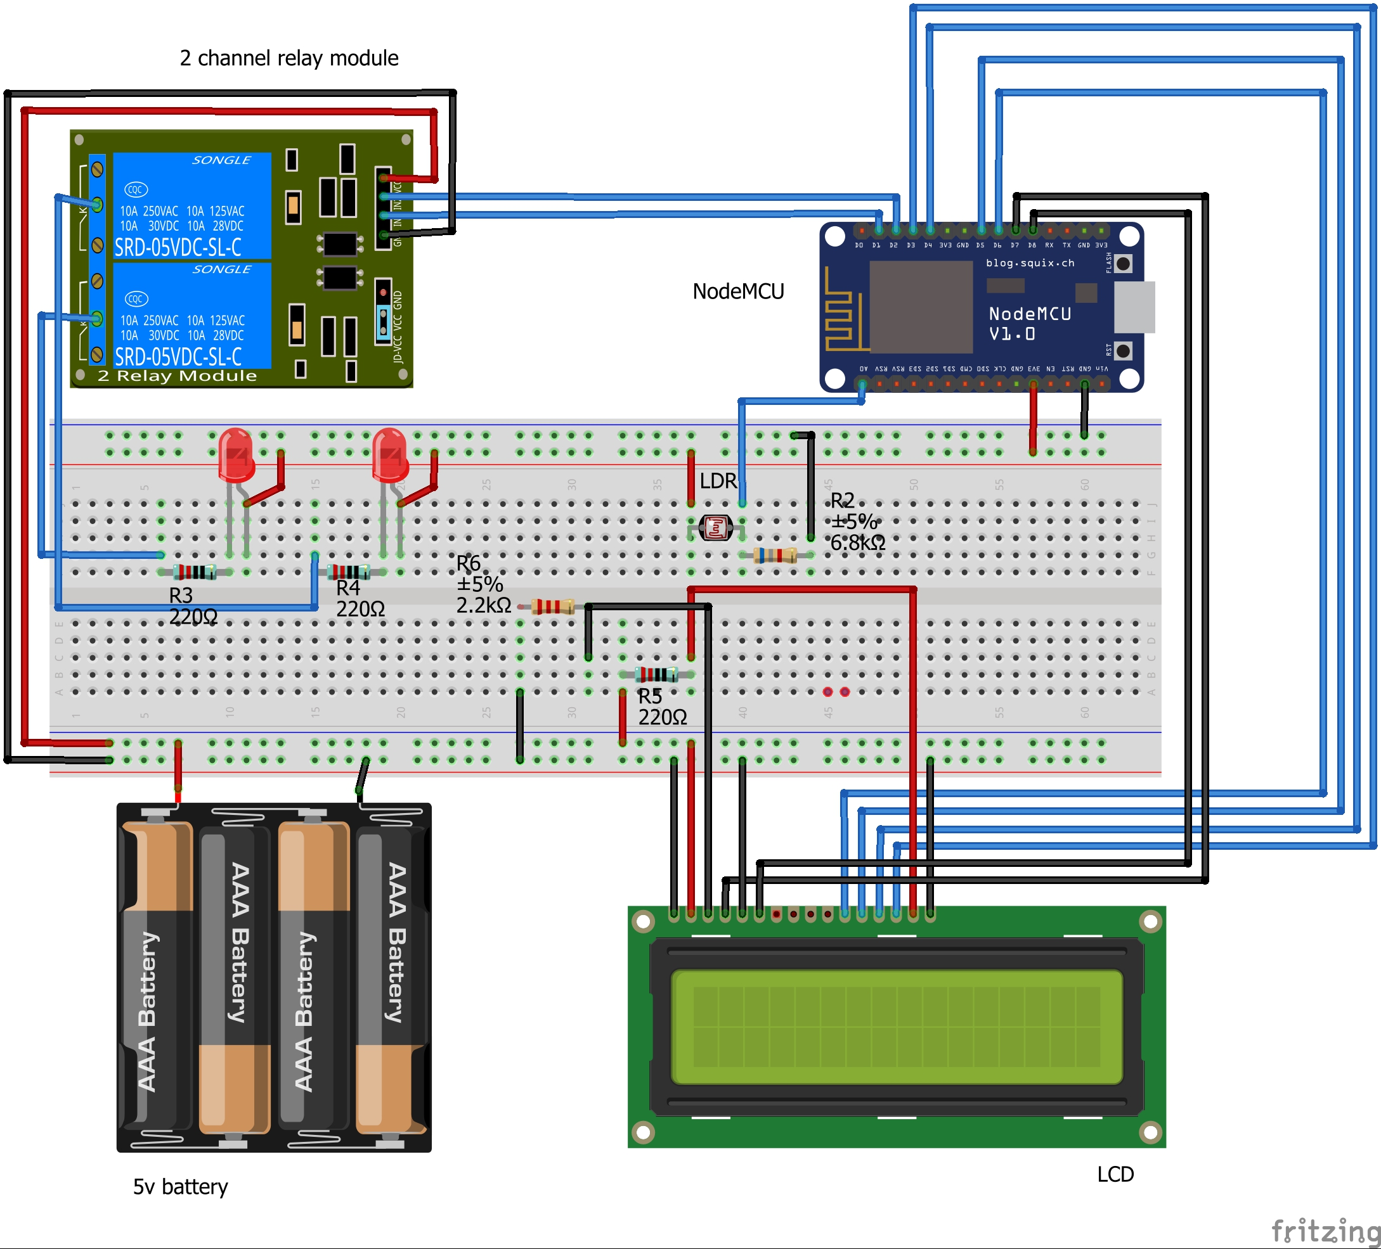
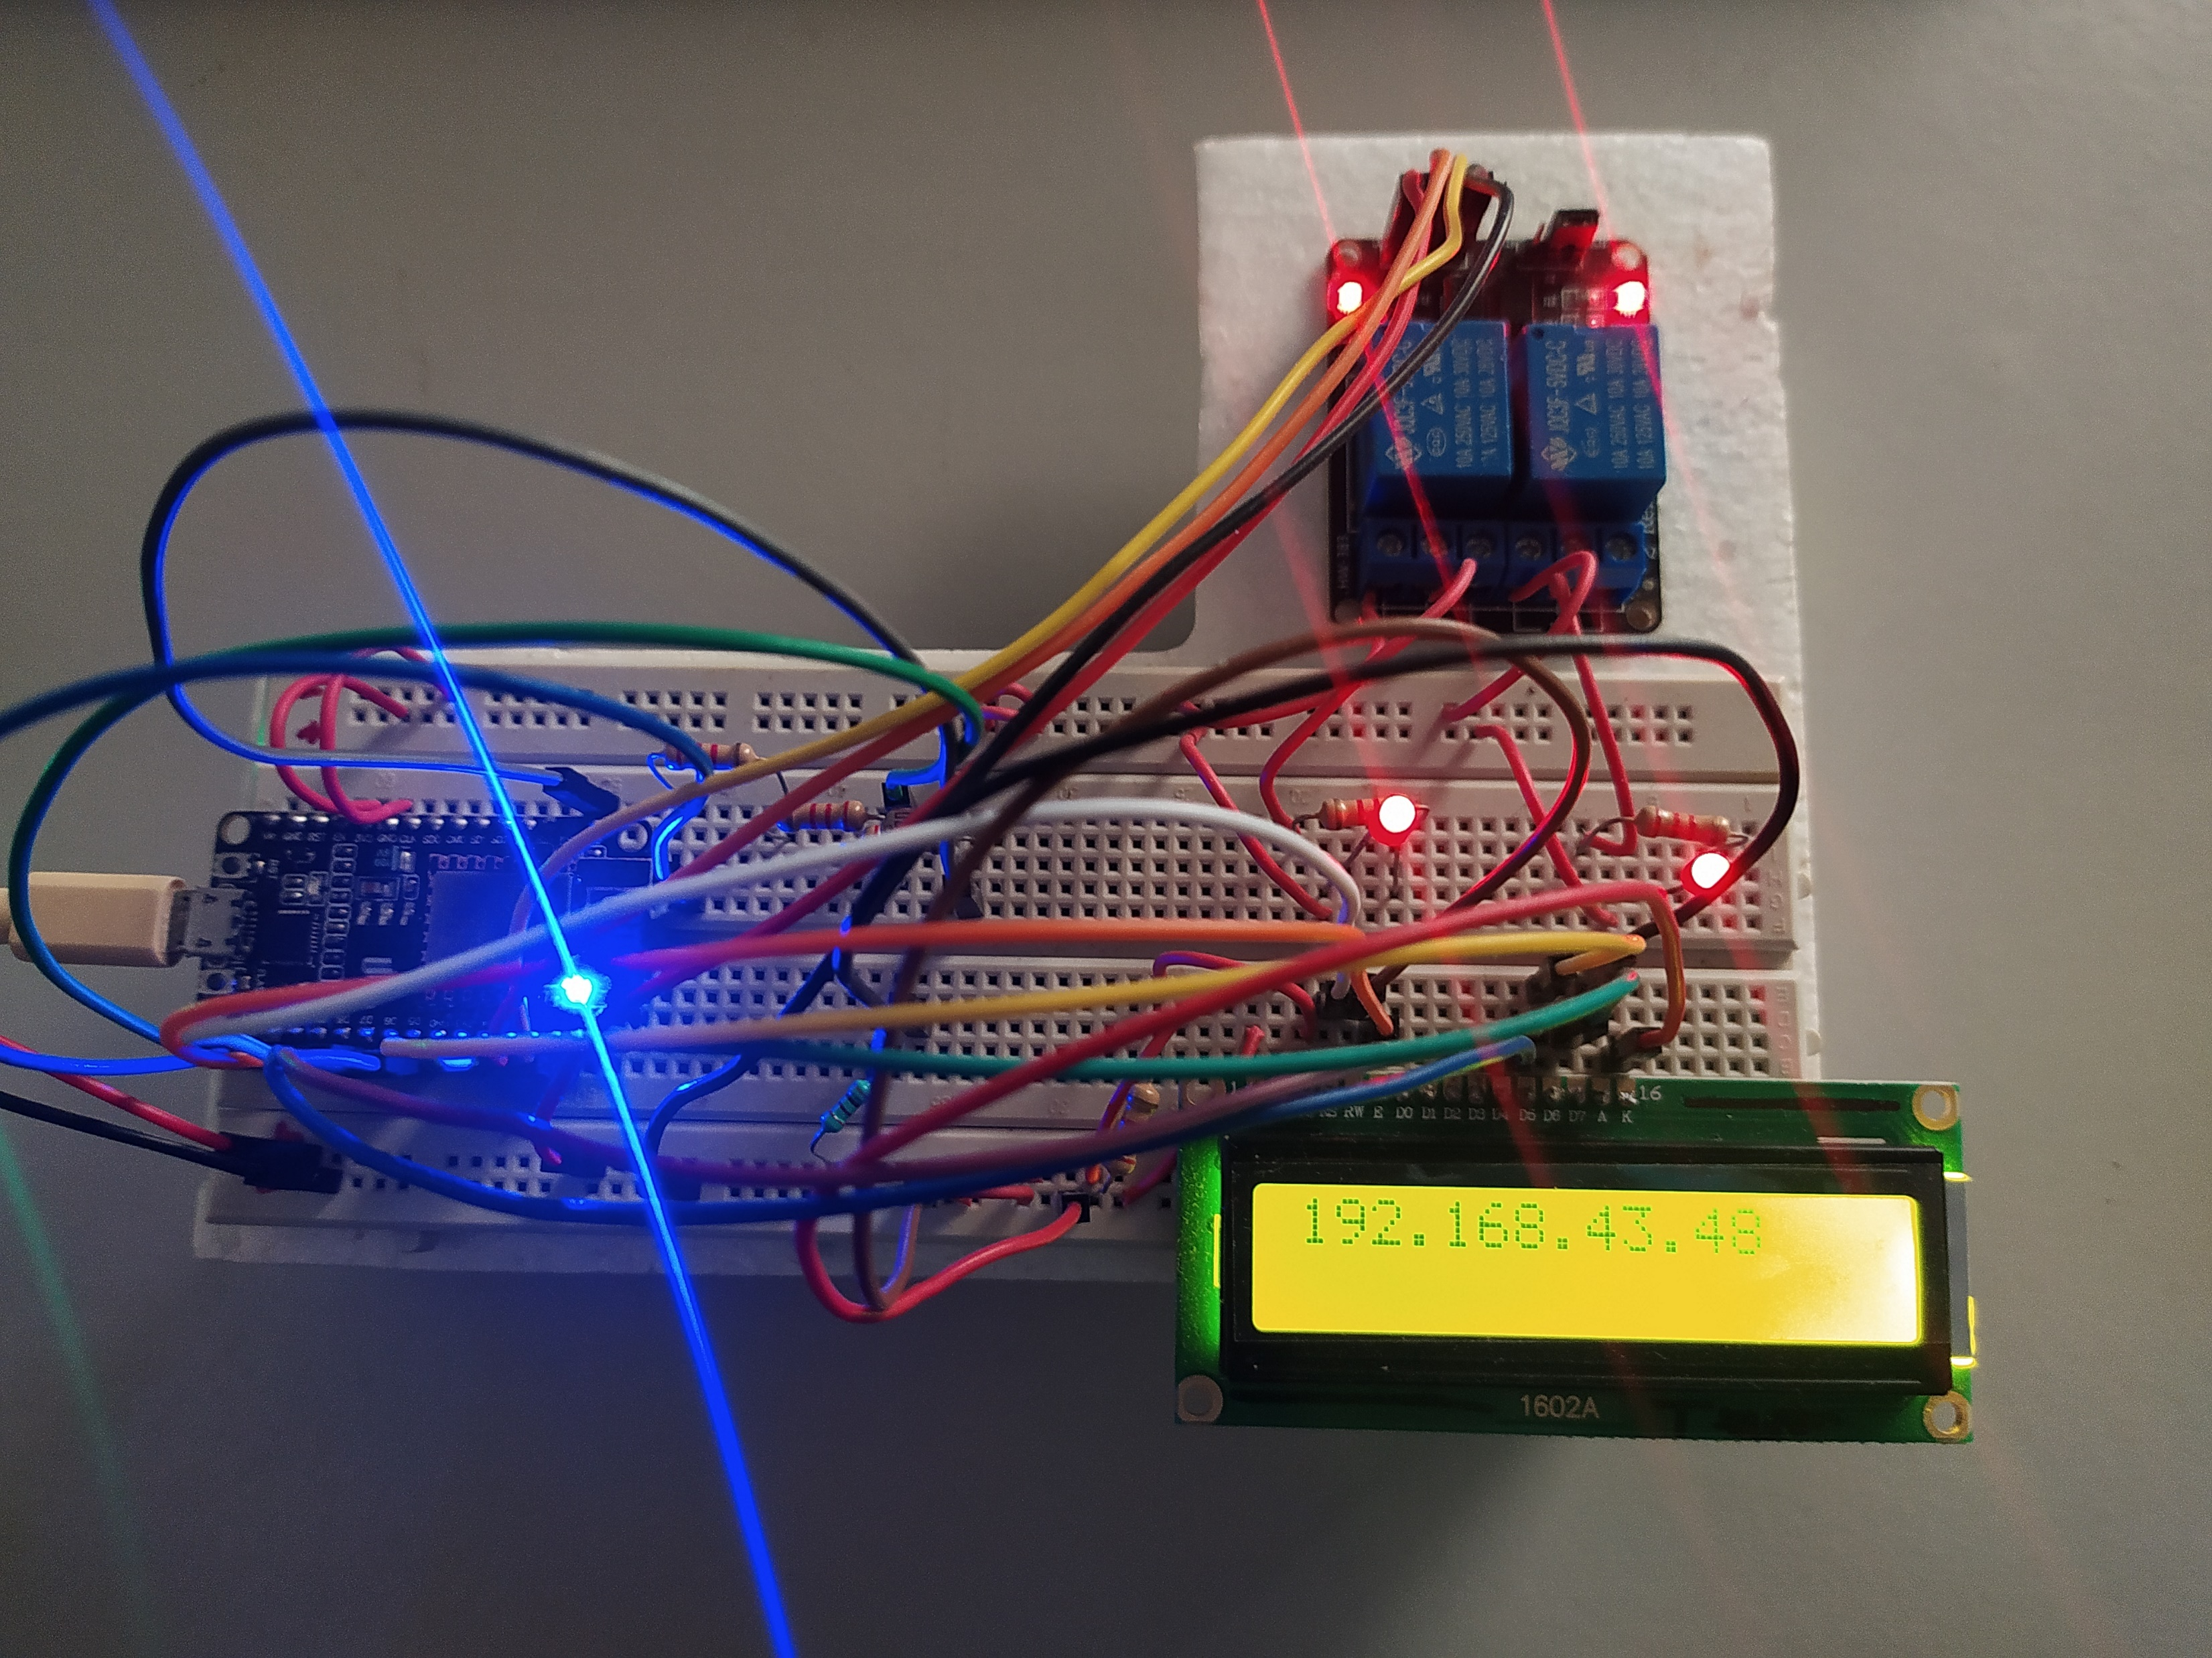
Working Model and Schematics
Figure 1 : Working Model
Figure 2 : Schematics

Slide 6
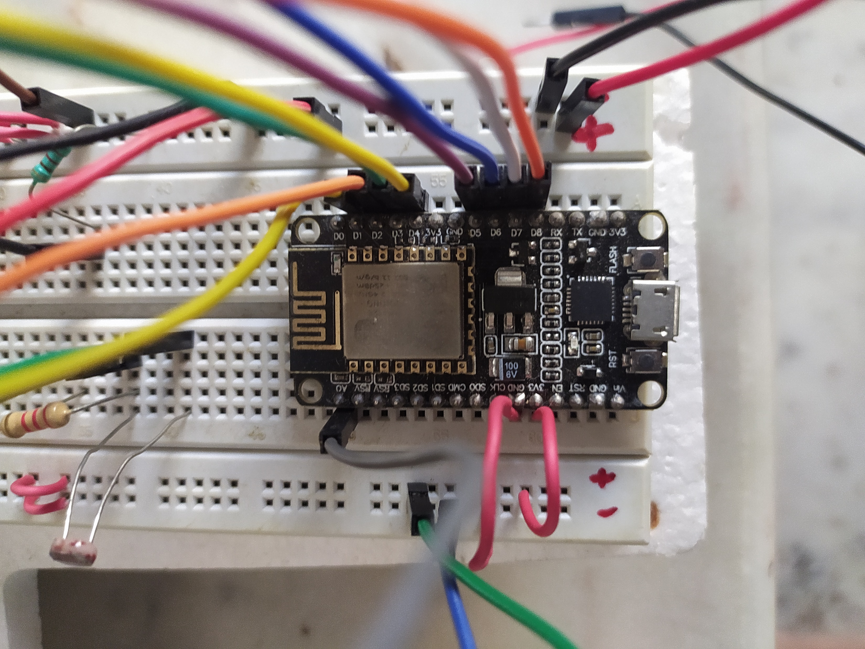
Components and Services
NodeMCU
The heart of project, to control the interfaced devices.
To send data to Thingspeak cloud.
It connects to the Wi-Fi to control devices via relay and display IP to LCD.
Figure 3 : NodeMCU

Slide 7
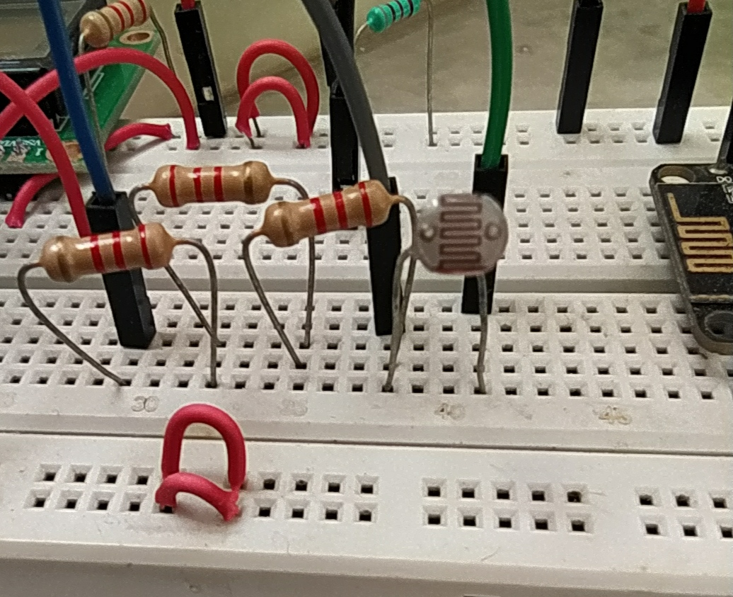
Components and Services
LDR sensor
To sense the amount of light and gather data to send to cloud.
Figure 4 : LDR

Slide 8
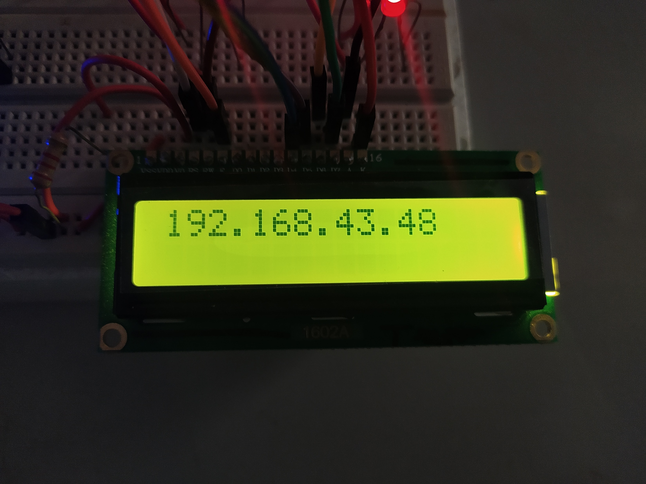
Components and Services
16×2 LCD Module
To display the received IP address, which will be useful to connect our smartphone to control appliances.
Figure 5 : LCD module

Slide 9
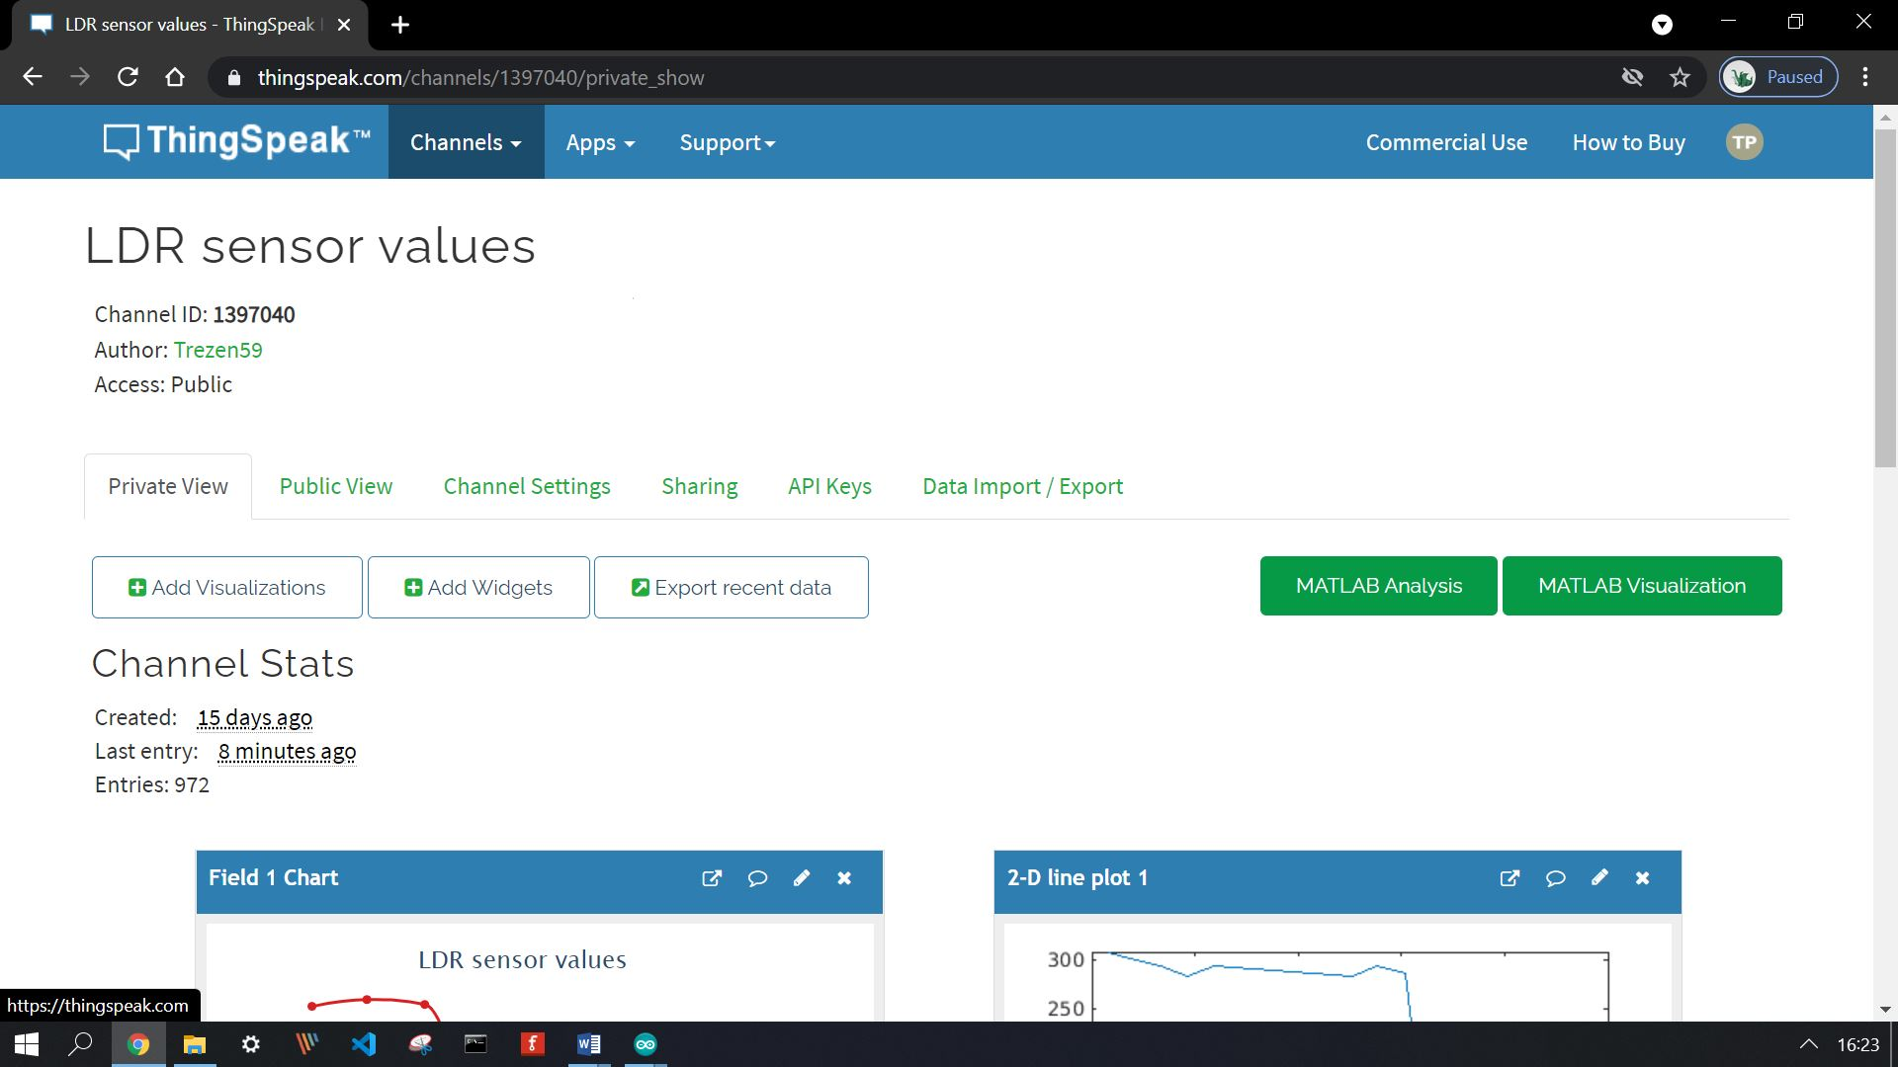
Components and Services
Thingspeak IoT cloud service.
To collect, process and visualize received data.
Sends HTTP request to IFTTT which further sends us notifications.
Figure 6 : Thingspeak

Slide 10
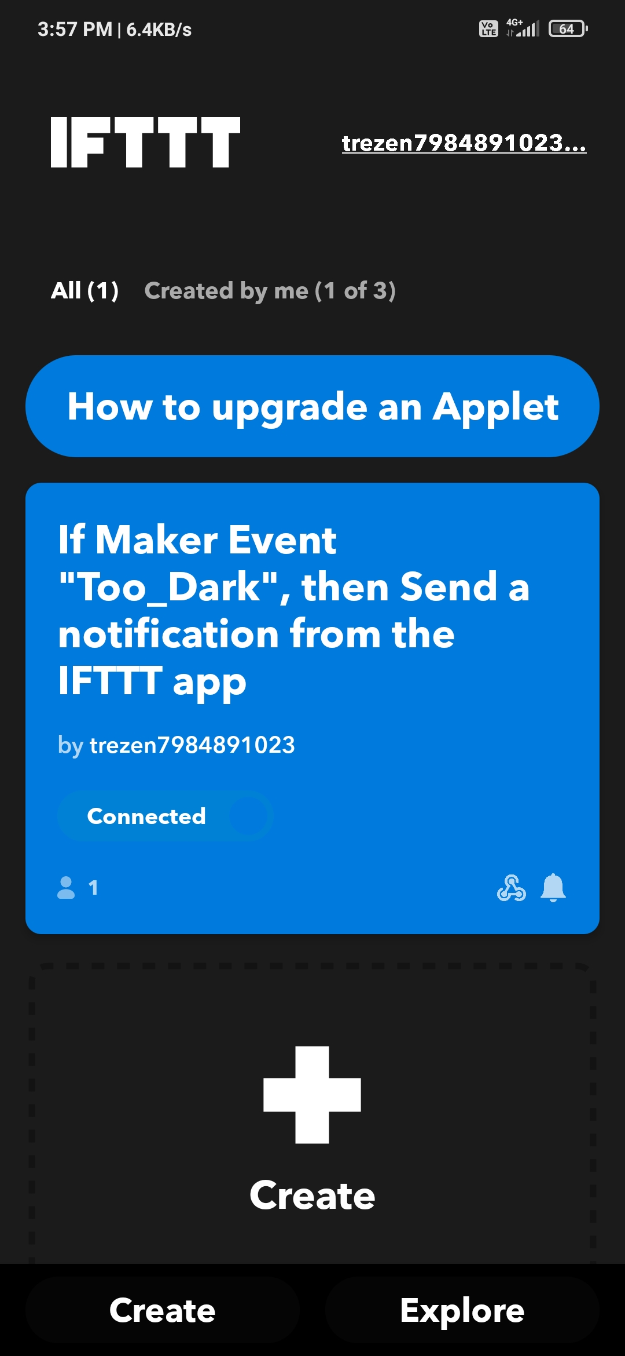
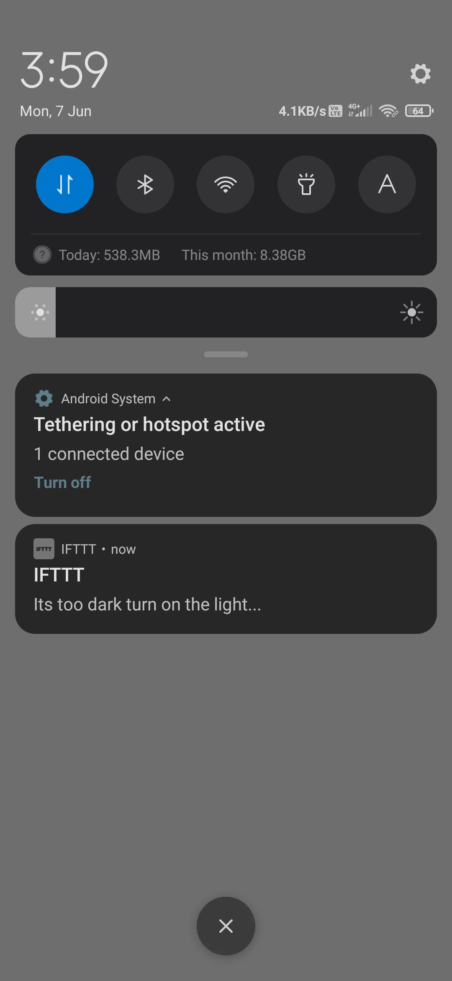
Components and Services
IFTTT Webhooks and Notifications.
To receive HTTP request from Thingspeak.
React to received HTTP request by sending notifications to your device.
Figure 7 : IFTTT applet
Figure 8: Notification

Slide 11
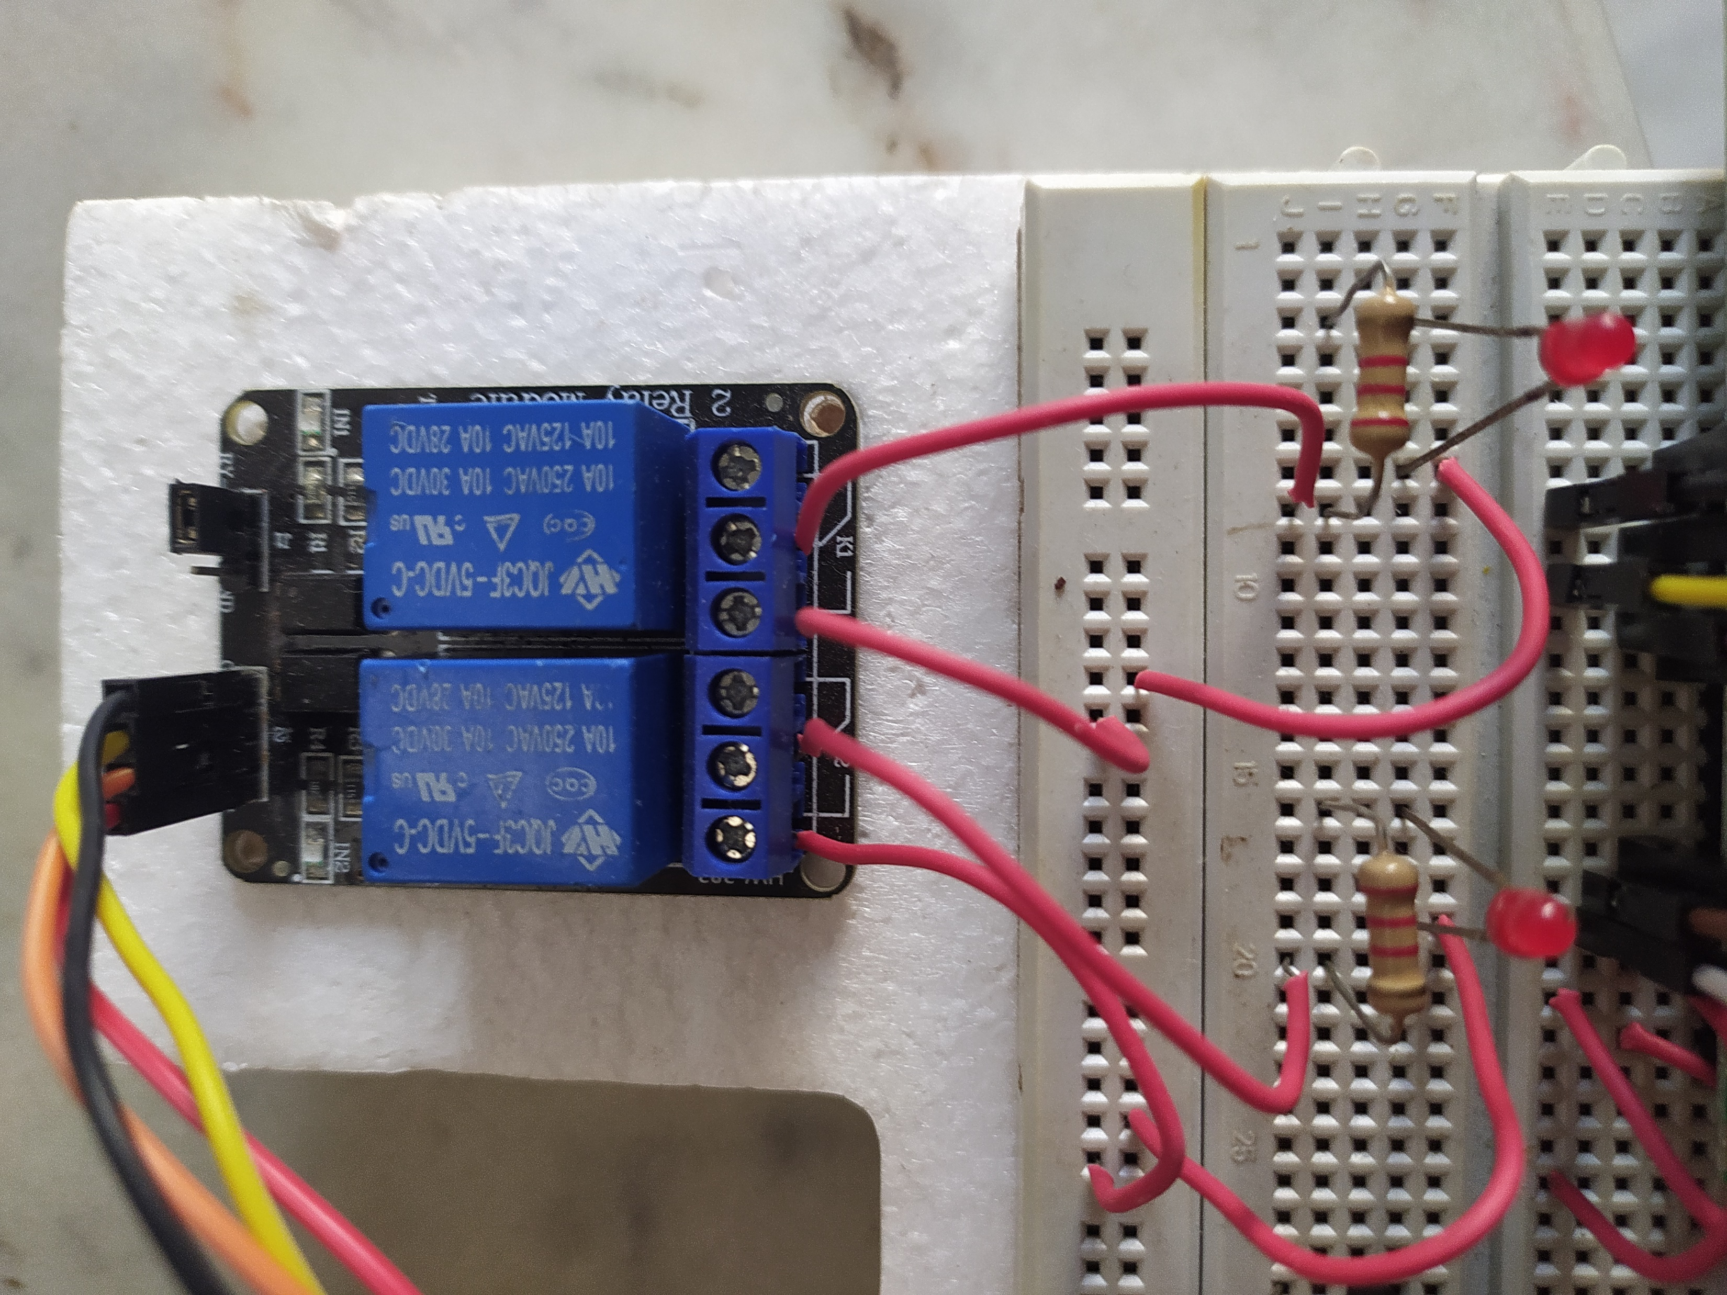
Components and Services
Relay Module
To control the high load appliances like lights, thermostats that can have effect on data values.
Figure 9 : Relay Module

Slide 12
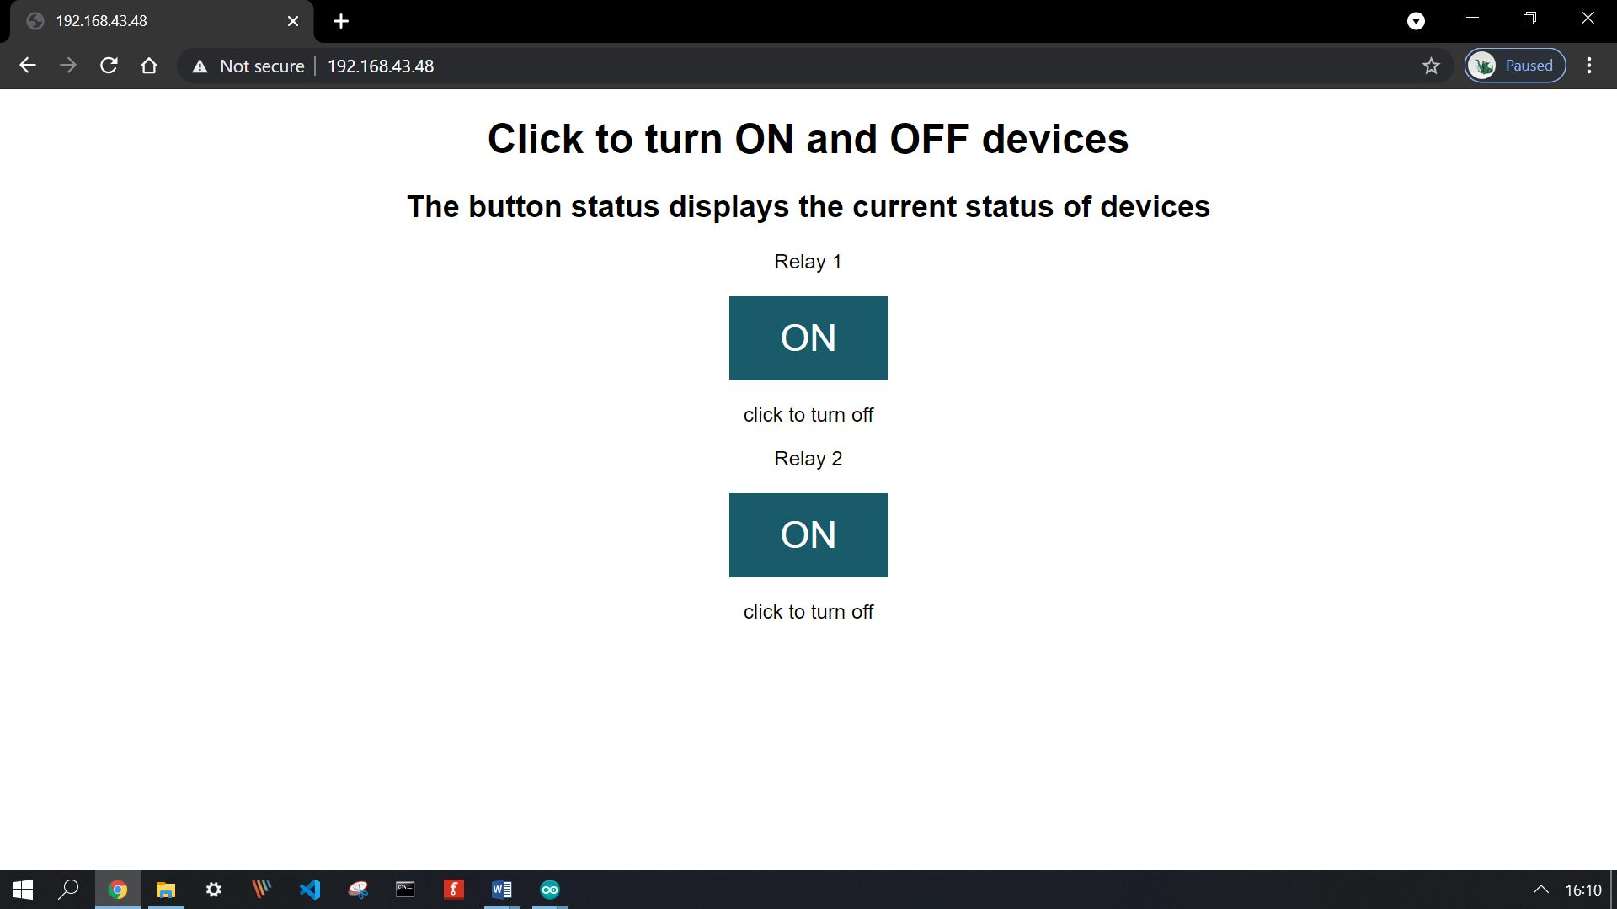
Components and Services
Web UI
To control the devices easily.
Interactive UI.
Fully responsive.(can be used on any device of any screen size)
Figure 10 : Web UI

Slide 13
Advantages
Enhances security and monitoring.
Easy management of large data.
Ease to handle and maintain.
Control from anywhere.
Better Operational efficiency.
Improve safety compliance.
Energy efficiency and savings.

Slide 14
Conclusion
The use of IoT in monitoring and automation will be playing a very important part in coming future.
This system makes human life easy and smart.
My project displays the power of IoT in society development.
This system is also capable to handle many sensors at once so it can even be used in industries and various businesses to monitor various environmental parameters efficiently and control them easily from anywhere.

Slide 15
Thank You

